Slide 1
Тема
Social media sentiment analysis: Use natural language processing techniques to analyze social media posts and identify trends in public opinion on a particular topic.

Slide 2
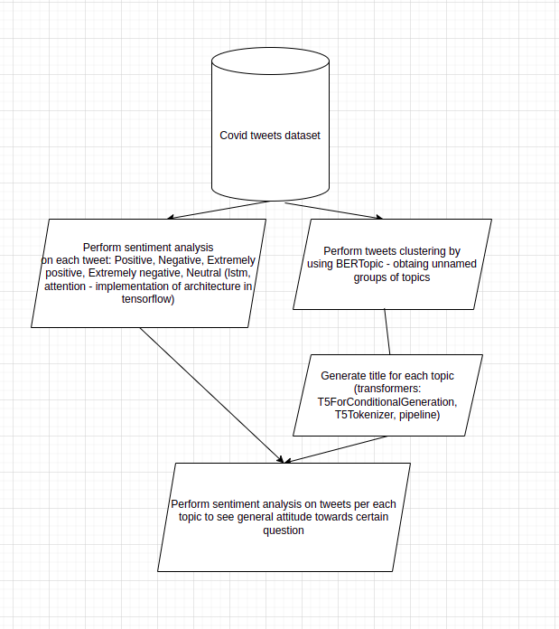

Slide 3
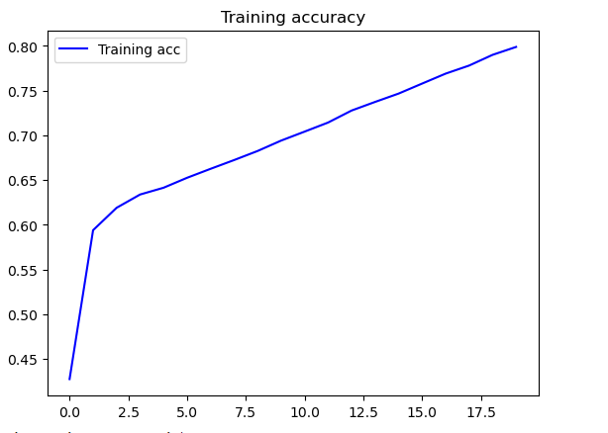
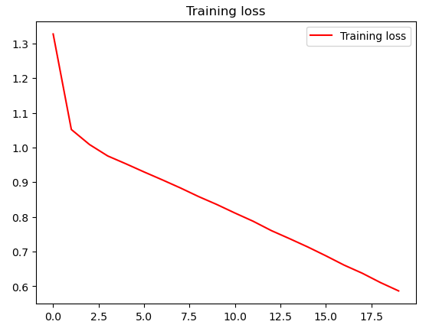
Training

Slide 4
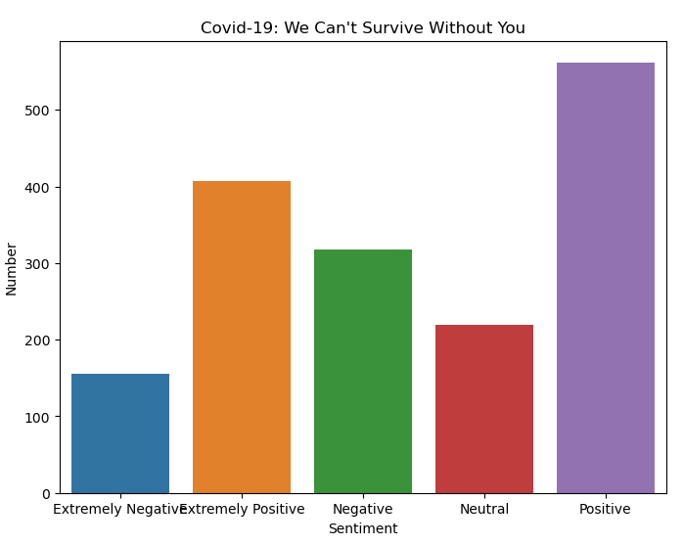

Result

